Slide 1
Work Breakdown Structure
Presentation

Slide 2
Creating the Work Breakdown Structure (WBS)
Project deliverable – an interim but tangible result achieved at some point time thru the project development. Can be used to evaluate the project state
A WBS is a deliverable-oriented grouping of the work involved in a project that defines the total scope of the project
Information Technology Project Management, Fifth Edition, Copyright 2007

Slide 3
Practical approaches to create WBS - by SDLC stages
Top-down: by SDLC stages
  Project definition
  Requirements development
  Solution Design
  Solution Implementation
  Testing
  Move to production
Complimentary activities
  Vendor selecting
  Training

Slide 4
Practical approaches to create WBS - by SDLC stages (cont)
How to:
  For each stage consider the tasks and activities required to complete the tasks
  Decompose from more generic to more detailed
  Use verbs, not nouns to articulate the tasks
  First, create a flat list and then do grouping

Slide 5
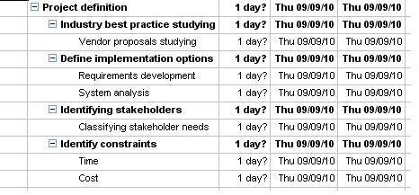
Practical approaches to create WBS - by SDLC stages (cont)
Example

Slide 6
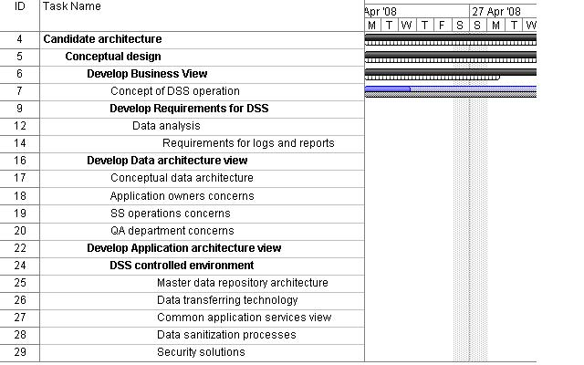
Practical approaches to create WBS - by SDLC stages (cont)

Slide 7
Practical approaches to create WBS – by Deliverables (cont)
Suitable for presentation purposes
In practice still must be converted into the activities to be understandable to team members

Slide 8
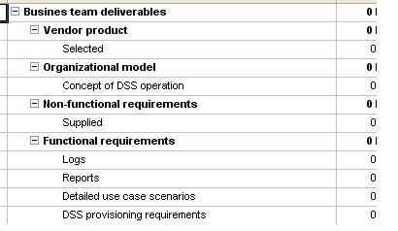
Practical approaches to create WBS – by Deliverables
List major deliverables
Decompose to smaller portions of it

Slide 9
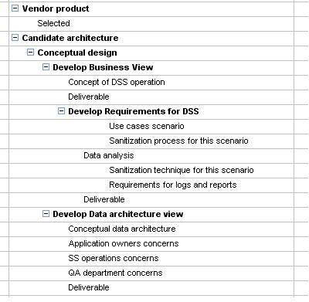
Practical approaches to create WBS – by Stages and Deliverables (cont)

Slide 10
Other things to do with WBS
Identify dependencies between the tasks
Identify milestones
  Critical deliverables
Assign the owner for each task
  One who is accountable
Identify tasks details (more information later)
  Resources required (skilled professionals, time estimate, money)
  Supplies (equipment, software)
  Completion criteria

